Slide 1
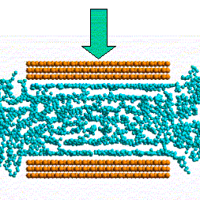
Confined Fluids
Presented By-
Jivesh Dixit
Sr. No. 08469

Slide 2
What are Confined Fluids?
They are any fluids in a closed system. Confined fluids can move a round within the system, but they cannot enter or leave the system.
When fluids are confined, they have some very
interesting effects.
Examples- The blood moving through your body is a confined fluid, the air in an air mattress, lubricant between mating parts, hydraulic or pneumatic braking system in vehicles etc.

Slide 3
Confined Fluids in Tribology
Understanding the atomic processes occurring at the interface of two dry or wet materials when they are brought together or moved with respect to one another is central to many technological problems in tribology, including adhesion, lubrication, friction, and wear.
Example- Hydrodynamic Bearings, lubrication of mating parts in motion(sliding or rotating) etc.

Slide 4
Introduction
A central property of fluid confined between solid boundaries that are smooth on the molecular scale is their tendency to organize into layered structures.
The mean local density oscillates with distance normal to the boundaries.
Liquids confined in ultra-thin gaps may exhibit different mechanical responses.

Slide 5
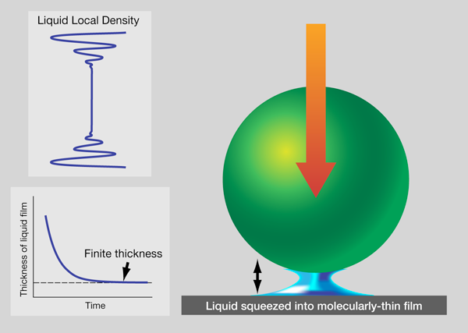
Schematic Illustration of a Confined Fluid
Notes:
Imagine that a liquid droplet is placed between a ball and a flat surface, and a ball is allowed to fall (right panel) onto it. When the thickness of the liquid is plotted schematically against time after the ball begins to fall, the film thickness remains finite at equilibrium (bottom left panel). This is because fluid tends to layer parallel to the solid surfaces. When the local liquid density is plotted against the distance between the solid boundaries, it shows decaying oscillations with a period of about a molecular dimension (top left panel). When these density waves shown in the bottom panel come sufficiently close to interfere with one another, the liquid can support force at equilibrium.

Slide 6
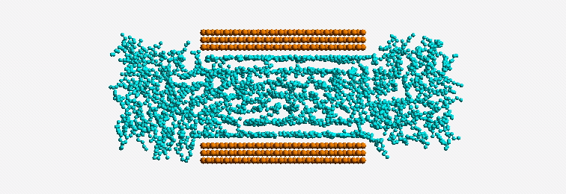
Behavior of Confined Fluid in contact with the bulk under the effect of External Pressure

Slide 7
Understanding the effect of external force on Confined Fluids (Particle Theory)
The spaces between the particles are already very small. When an external force is applied, only a small decrease takes place in the liquid’s volume.
In a gas, the particles are far apart from each other. In order for the force to be transmitted from one particle to another, the volume the gas occupies must be reduced.
There is another effect that can occur when a force is applied to a gas or a liquid. Its state can be changed.

Slide 8
Polar vs. Non Polar fluids
If the fluid is such that the torques within it arise only as the moments of direct forces we shall call it nonpolar. A polar fluid is one that is capable of transmitting stress couples and being subjected to body torques, as in polyatomic and certain non-Newtonian fluids.
Notes:
"Vectors, Tensors, and the Basic Equations of Fluid Mechanics" by Rutherford Aris.

Slide 9
Confined water controversies ( thin film of water between two solid boundaries)
Water confined between the oscillating AFM tips and a single crystal (mica) shows progressively more sluggish mechanical relaxation as the film thickness decreases below 3–4 diameters of the water molecule.
In this case a nonpolar fluid of compact shape, and reported a progressive dynamic slowdown upon increasing confinement between parallel single crystals (mica).
Notes:
A pleasing resolution of earlier contradictory findings is presented in Physical Review Letters by Shah Khan, George Matei, and Peter Hoffmann of Wayne State University in the US, writing with Shivprasad Patil of the Indian Institute of Science Education and Research, Pune, India. In an experimental tour de force, they use atomic force microscopy (AFM) to make precise measurements of phase during sinusoidal oscillations of the film thickness with an amplitude that is less than the diameter of a water molecule, giving them access to the important linear-response region, which was inaccessible to most prior measurements. Their main result is that, provided that the confined film is formed at a rate that exceeds some critical value, water confined between the oscillating AFM tips and a single crystal (mica) shows progressively more sluggish mechanical relaxation as the film thickness decreases below 3–4 diameters of the water molecule. (Viscous losses pass through maximum then subsequently decrease.)
In a similar spirit, also noteworthy in its resolution of earlier contradictory findings regarding confined fluids, is a study in Physical Review Letters[12] in which Lionel Bureau of the CNRS-Université Paris 6, France, studied an entirely different fluid, in this case a nonpolar fluid of compact shape, and reported a progressive dynamic slowdown upon increasing confinement between parallel single crystals (mica).

Slide 10
Physical Behavior
Confined fluids are neither like bulk fluids nor like bulk crystalline solids. They appear to be an intermediate kind of matter whose finite size and surface-fluid interactions impart unique structural, thermodynamic, and dynamic properties.
Their inherently heterogeneous character and sluggish relaxation times are reminiscent of super-cooled fluids.

Slide 11
Hydrodynamic properties of Confined Fluids

Slide 12

Boundary Conditions
Any ‘microscopic’ BC reduces on a macroscopic scale to the no-slip BC.
Simplest generalization of the no-slip BC that allows for a velocity slip at the fluid-wall interface:
$$\frac{{∂v}_{α}(r,t)}{∂z}= \frac{1}{δ_{wall}}v_{α}(r,t)|_{z=z_{wall}} (α=x,y)$$
Where;
$v$(r, t)= velocity field,
$δ_{wall}$= slipping length,
$z_{wall}$= location of hydrodynamic boundary

Slide 13

Transport Properties
The GK(Green–Kubo) relation for diffusion connects $D_{∥}$ to the velocity autocorrelation function (ACF),
$$D=\int_{0}^{+∞}{dt<v_{x}(t)v_{x}(0)>}$$
$$<v_{x}\left(t\right)v_{x}\left(0\right)>∼t^{−1}exp⁡(−υ{(\frac{π}{h})}^{2}t)$$
$\left(\frac{D_{∥}−D_{bulk}}{D_{bulk}}\right)=−\left(\frac{Alog\left(\frac{h}{σ}\right)+B}{\frac{h}{σ}}\right)+𝒪(\frac{1}{h^{2}})$
Where, $D_{∥}$= diffusion constant(parallel to wall),
$D_{bulk}$= bulk diffusion constant,
h= film thickness,
$σ$= particle diameter,
A,B= two (positive) numerical constants

Slide 14

Questions & Comments

Slide 15

Thank you for listening me ☺

